Slide 1

IMPORTANCE OF KEEPING THE ENVIRONMENT CLEAN AND SAVING EARTH
A Presentation by Sonny Simon Kothapally
Grade 11 Science

Slide 2
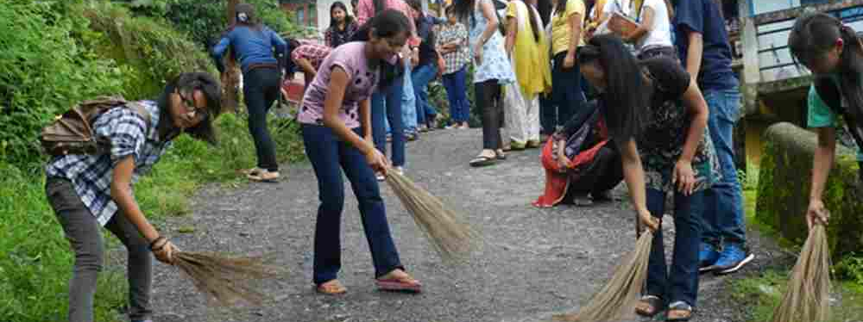
Cleanliness
Cleanliness can be defined as the state of being clean and free from dirt and dust and other impurities. Cleaning is the removal of filth and dirt accumulation.

Slide 3
Why Should We Keep Our Environment Clean?
It is important to keep the environment clean because a clean environment minimizes energy waste and it improves our quality of life. It also protects the earth and nature from all kinds of diseases. Furthermore, it maintains a balanced ecosystem and sustains life on earth by protecting living things from all kinds of harmful diseases.

Slide 4
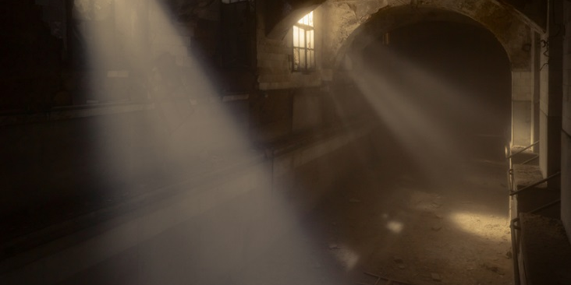
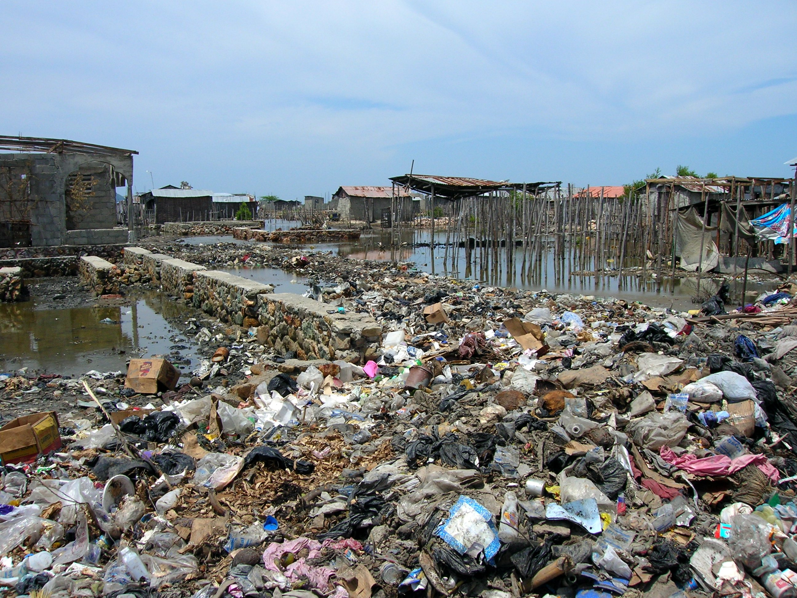
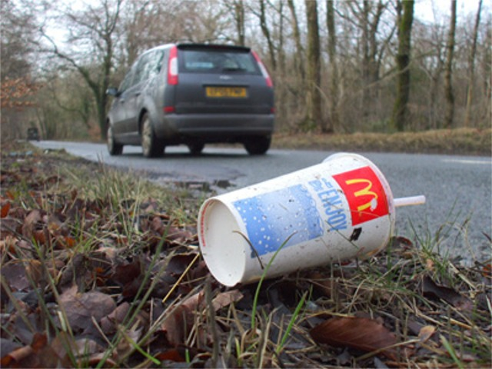
What Make The Surroundings Unclean?
Aerosols
Waste/Garbage
Littering
Dust particles floating in the air are called aerosols. All air contains these aerosols in large numbers. Normal outdoor air contains usually over 40 million particles per cubic meter air measuring over 0.3 µm.
Waste is the refuse or the unwanted substance disposed of from industrial, commercial, agricultural processes or from domestic activities. These unwanted substances may be rejected or stored, or treated with chemicals, or may be recycled.
This is the improper disposal of products, after they have been used , at an inappropriate location without consent.

Slide 5
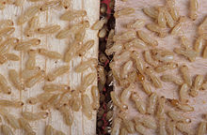
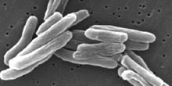
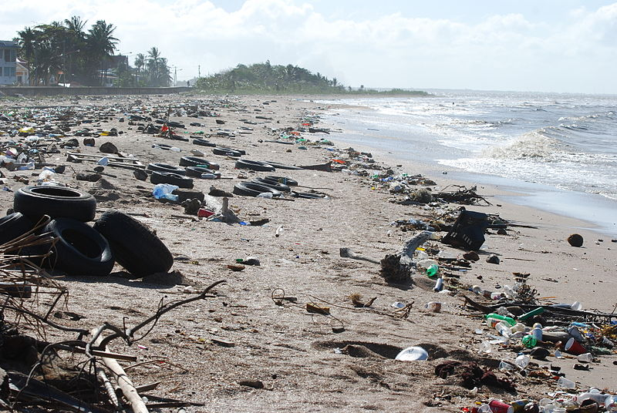
Effects Of Unclean Surroundings
Pests
Disease
Pollution
Pests are relatively tiny organisms which are deemed harmful to the human society.
A disease is an abnormal condition that affects the body of its host.
Pollution is the introduction of contaminants into the natural environment that cause adverse change. Pollution can take the form of chemical substances or energy, such as noise, heat or light.

Slide 6
What Is Water?
Water is a chemical compound containing the chemical formula H₂O. Water covers 71% of the Earth's surface, is vital for all known forms of life and there are various theories about the origin of water on Earth. On Earth, 96.5% of the planet's water is found in seas and oceans, 1.7% in groundwater, 1.7% in glaciers and the ice caps of Antarctica and Greenland, a small fraction in other large water bodies, and 0.001% in the air as vapor, clouds, and precipitation. Only 2.5% of the Earth's water is freshwater, and 98.8% of that water is in ice and groundwater. Less than 0.3% of all freshwater is in rivers, lakes, and the atmosphere, and an even smaller amount of the Earth's freshwater (0.003%) is contained within biological bodies and manufactured products. Water is the main body affected mainly by unclean surroundings. Therefore, it is vital that we conserve it.

Slide 7
How Do We Conserve Water?
Though the pollution of water is detrimental, conserving it is rather simple. Some ways are:
- Take shorter showers
- Water during the early parts of the day; avoid watering when it's windy
- Turn off the water after you wet your toothbrush
- For more immediate hot water and energy savings, insulate hot water pipes
- Cook food in as little water as possible. This helps to retain more nutrients and save water.

Slide 8
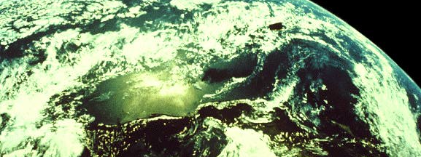
The Earth
Earth is the third planet from the Sun. It is the densest and fifth-largest of the eight planets in the Solar System. It is also the largest of the Solar System's four terrestrial planets. It is sometimes referred to as the world or the Blue Planet due to the water it contains.

Slide 9
Earth Day
Our planet is truly a magnificent place. Known as the Blue Planet due to its abundance of water, the Earth is an incredibly complex and vibrant ecosystem, where living organisms interact with each other and their environment to create the ideal conditions for life. We have it all: it’s warm but not too warm, lots of water but again, not too much. It’s perfect. And it’s in trouble.
Which brings us to Earth Day.
In this day and age of instant information, we are finally beginning to understand the consequences of our actions and the impact they are having on our world and our survivability as a species. Wherever you look, nature is under assault and if we don’t take steps now to try and repair the damage, there might not be much of a world left for our children to pass onto theirs.
Earth Day is important. It educates us about what we have and what we are losing by acting in ways that aren’t environmentally friendly or energy efficient. Earth Day reminds us that we need to take action now to protect our environment before it’s too late.

Slide 10
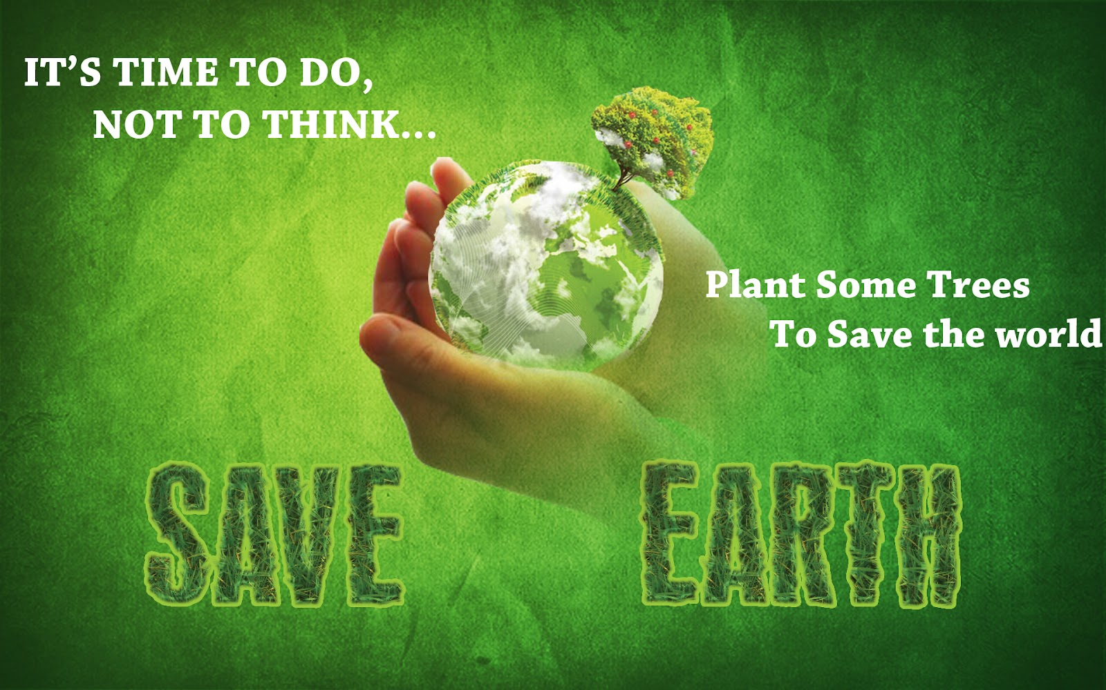

Slide 11
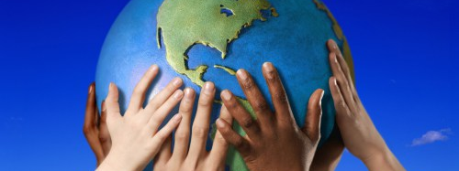
Thank You
For taking your time off to read this assessment. Sincere gratitude is given to Abdul Field and all other individuals who have contributed information of grave importance in this project. It is inexpressible how much we owe you all.

